Slide 1
Artificial Neural Network and Convolutional Neural Network

Slide 2
What is an Image?
Every image consists of a set of pixels.
Pixels are the raw building blocks of an image.
If the image has a resolution of 600 x 450, meaning that it is 600 wide and 450 pixels tall. Then, there are 600 x 450 = 270,000 pixels in our image.
Grayscale image, each pixel has a value between 0 and 255, where zero is corresponds to “black” and 255 being “white”. The values in between 0 and 255 are varying shades of gray.
Color pixels are normally represented in the RGB color space (one value for the Red component, one for Green, and one for Blue, leading to a total of 3 values per pixel).
1

Slide 3

General Structure of Neural Network
Various layers in NN

Slide 4
Neural Network
Neural Network have three layers in it, they are
Input Layer :
Input layer consists of number of nodes that is equivalent to the number of pixels in input image.
E.g:
If Input image dimension is 50x50x3.(3 channel for color image)
Input layer nodes = 50x50x3=7500 nodes.
Hidden layer(s):
Each hidden layer is made up of a set of neurons, where each neuron is fully connected to all neurons in the previous layer.
There may be many layers used as hidden layer but it is commonly termed as hidden layer.

Slide 5
Neural Network
Output layer:
Output layer consist of number of nodes equivalent to the number of classes in dataset.
We use Activation function mostly Softmax which gives probability values from 0 to 1.
E.g:
binary classification : n=1
output layer nodes= 1
multiclass classification (lets take n=10)
output layer nodes= 10

Slide 6
Node/Neuron and Weights
Neurons are the fundamental building blocks of a neural network. Neurons are used for receiving input, processing input and generating output.
Depending on the layer in which neurons are present they perform different functionalities.
The neurons in a neural network are inter-connected and each connection has an associated weight assigned to it.
We initialize the weights randomly and these weights are updated during the model training process.

Slide 7
Activation Function
The function is attached to each neuron in the network, and determines whether it should be activated (“fired”) or not, based on whether each neuron’s input is relevant for the model’s prediction.
Activation functions introduce non-linearity into neural networks.
Without these activation functions, neural networks will be very similar to that of a linear model.
Commonly used activation functions includes,
sigmoid,
tanh,
ReLu,
softmax.

Slide 8

Activation Function

Slide 9
Training the NN
Dataset is loaded. Then weights are randomly initialized, then activation function is chosen as per our needs.
After configuring the neural network, Training Artificial Neural Network involves two steps:
i) Forward Pass (Feed Forward)
Backward pass (Back Propagation)
Forward Pass:
The training samples are passed to the neural network with the input and target (i.e. Forward pass). Then loss/error is calculated.
Backward pass:
Based on loss/error, Cost function J(θ) is calculated.
Then weights are updated as per the cost functions.
At the end, the optimal weights and biases are learnt by the network.

Slide 10
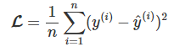
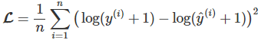
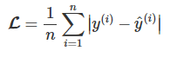
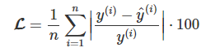
Various losses in NN
The main aim of Loss Function is find the loss/error between the predicted value and actual value. There are many loss function available such as,
Mean Squared Error: (most commonly used)
ii) Mean Squared Logarithmic Error:
iii) Mean Absolute Error:
iv) Mean Absolute Percentage Error:
Where
Ӯ - predicted value
Y - real value

Slide 11
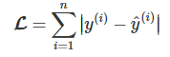
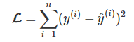
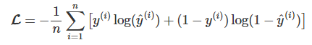
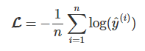
Various losses in NN
v) L1 loss function:
vi) L2 loss function:
vii) Cross Entropy loss function:
viii) Negative Logarithmic Likelihood loss function:
Where
Ӯ - predicted value
Y - real value

Slide 12
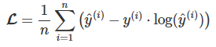
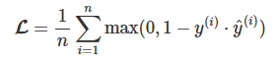
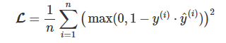
Various losses in NN
ix) Poisson loss function:
x) Hinge loss function:
xi) Squared Hinge loss function:
Where
Ӯ - predicted value
Y - real value

Slide 13
Optimizers
During the training process,
we calculate the loss function,
we tweak and change the parameters (weights) of our model to try and minimize that loss function,
At the end, we make our predictions as correct as possible.
But how exactly do you do that?
How do you change the parameters of your model?
by how much?
When to update the weights?
The answer is Optimizer…

Slide 14
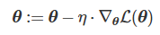
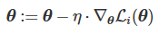
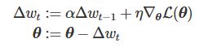
Various Optimizer in NN
Optimizer holds the key for weight update rule. We have lot of optimizer each one have different weight update rule/equation.
Vanilla Gradient Descent
Stochastic Gradient Descent (commonly used)
Momentum
Where
θ - predicted value
η - Learning rate
L(θ) - the partial derivative of L(θ) with respect to θ

Slide 15
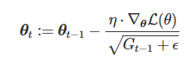
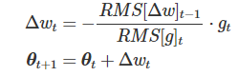
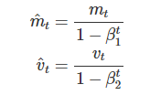
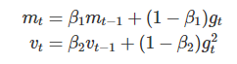
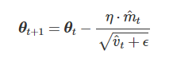
Various Optimizer in NN
iv) AdaGrad
v) AdaDelta
vi) Adam

Slide 16
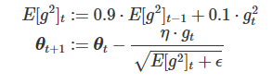

Various Optimizer in NN
iv) RMSProp (commonly used)

Slide 17
Why not ANN?
Regular Neural Nets don’t scale well to full images.
Lets consider, images are only of size 32x32x3 (32 wide, 32 high, 3 color channels), so a single fully-connected neuron in a first hidden layer of a regular Neural Network would have 32*32*3 = 3072 weights. (This amount still seems manageable)
Lets consider, an image of more respectable size, e.g. 200x200x3, would lead to neurons that have 200*200*3 = 120,000 weights.
For single hidden layer we have this much weights, and the huge number of parameters would quickly lead to overfitting.
Sometimes it would be computationally take long time.

Slide 18
Why CNN ?
Not Every neurons connected to every other neurons in next layer
Since we are using convolution operation, the number of parameters will reduce based on the certain things such as filter size, pooling layer , activation function.
CNN architecture are made in a more sensible way
CNN architecture are arranged in such a way that it will learn more specific and required features.

Slide 19
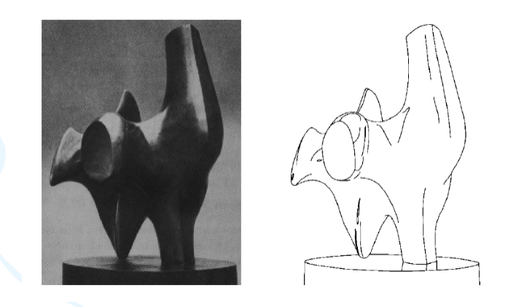
Edge Detection
1

Slide 20
The Prewitt Edge Detector
1 | 1 | 1
0 | 0 | 0
-1 | -1 | -1
1 | 0 | -1
1 | 0 | -1
1 | 0 | -1
Horizontal Edge Detector
Horizontal Edge Detector

Slide 21
Sobel Edge Detector
1 | 1 | 1
0 | 0 | 0
-1 | -1 | -1
1 | 0 | -1
1 | 0 | -1
1 | 0 | -1
Horizontal Edge Detector
Horizontal Edge Detector

Slide 22
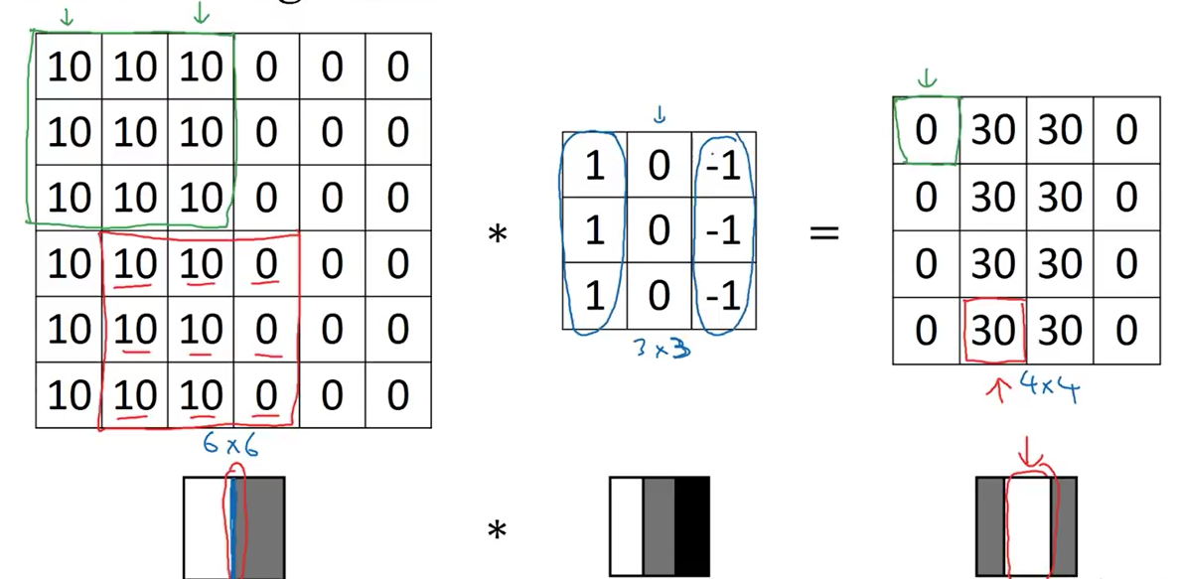
Vertical Edge Detection

Slide 23
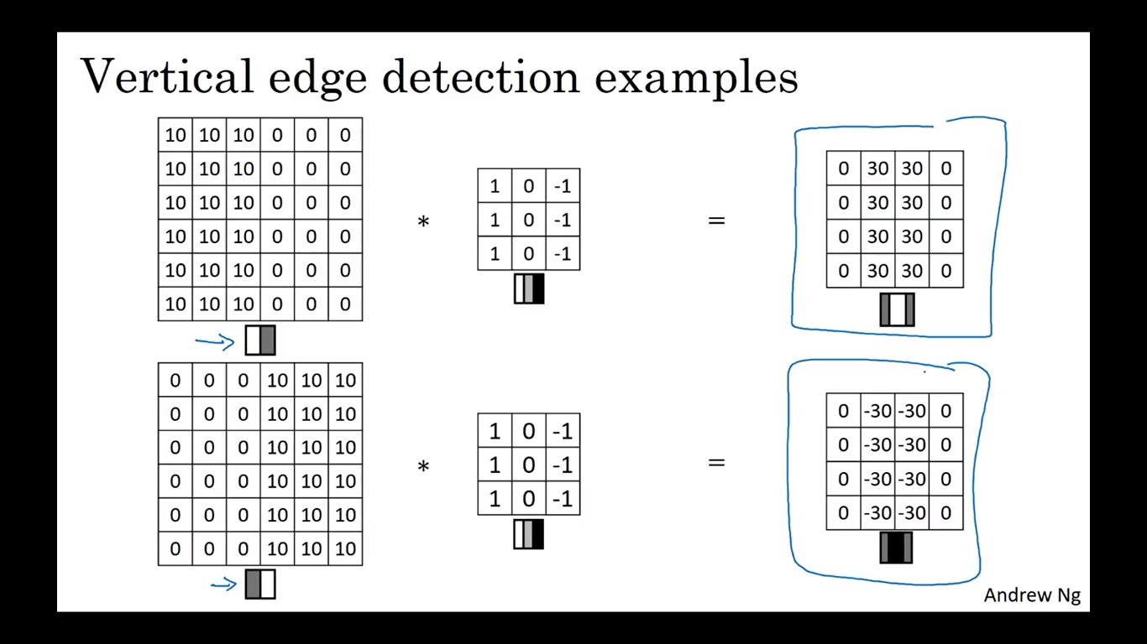
Transitions in Edge Detection

Slide 24
Dataset Preparation
Test
10%
Validate
20%
Train
70%
Validate
20%
Train
80%
Dataset
Dataset

Slide 25
Dataset Augmentation
Used for There are many augmentation techniques available, some of them are
Horizontal Flipping.
Vertical Flipping.
Rotating.
Cropping.
Zooming and scaling.
Translating (moving along the x or y axis).
Adding Gaussian noise (distortion of high frequency features).
Note: Sometimes augmentation depends on type of algorithm we are using.

Slide 26
Key Terminalogy
Filter/Feature Detector/weights
Feature map (CNN)
Activation function f(b + ∑ x_{i}·w_{i})
Feed Forward
Backpropagation
Cost function J (θ)
Loss function (Error)
Optimizer (SGD, Adam, RMSProp,..)
Learning Rate (η or α)
Epoch
Dropout

Slide 27
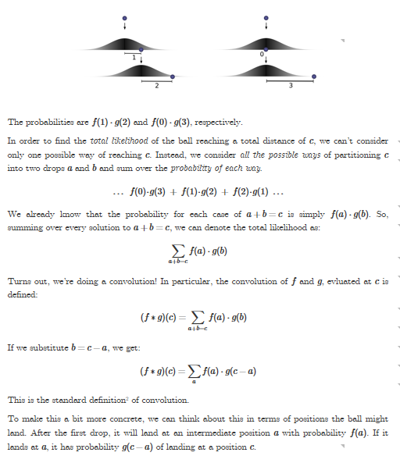
What is convolution?

Slide 28
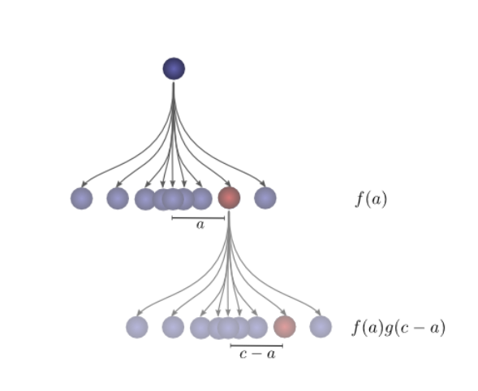
Why convolution in Neural Network?

Slide 29
Convolutional Neural Networks (CNN)
CNNs are popular because people are achieving state-of-the-art results on difficult computer vision and natural language processing tasks.
Convolutional Neural Networks expect and preserve the spatial relationship between pixels by learning internal feature representations using small squares of input data.
This is fair enough, but converting of the image matrix of pixels to a long vector of pixel values looses all of the spatial structure in the image.
Features are learned and used across the whole image, allowing for the objects in the images to be shifted or translated in the scene and still detectable by the network.

Slide 30
Building Blocks of CNN
There are three types of layers in a Convolutional Neural Network:
1. Convolutional Layer.
2. Activation layer (ReLU Layer)
3. Pooling Layer.
4. Fully connected Layer.

Slide 31
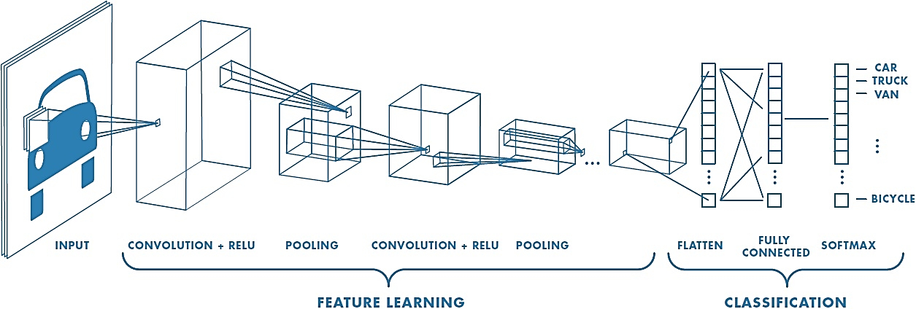
Convolutional Neural Networks (CNN)
CNN layers: Overview

Slide 32
Convolutional Neural Networks (CNN)
CNN architecture overview

Slide 33

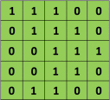
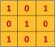
Convolution Operation
We define a weight matrix (must be m x m size) which extracts certain features from the images.
The convolution operation is performed by taking the dot multiplication of input image with weight matrix.
This weight shall now run across the image such that all the pixels are covered at least once, to give a convolved output.
The initial layer extract more generic features, while as the network gets deeper, the features extracted are more and more complex and more suited to the problem at hand.
3x3 weight
5x5 input image

Slide 34
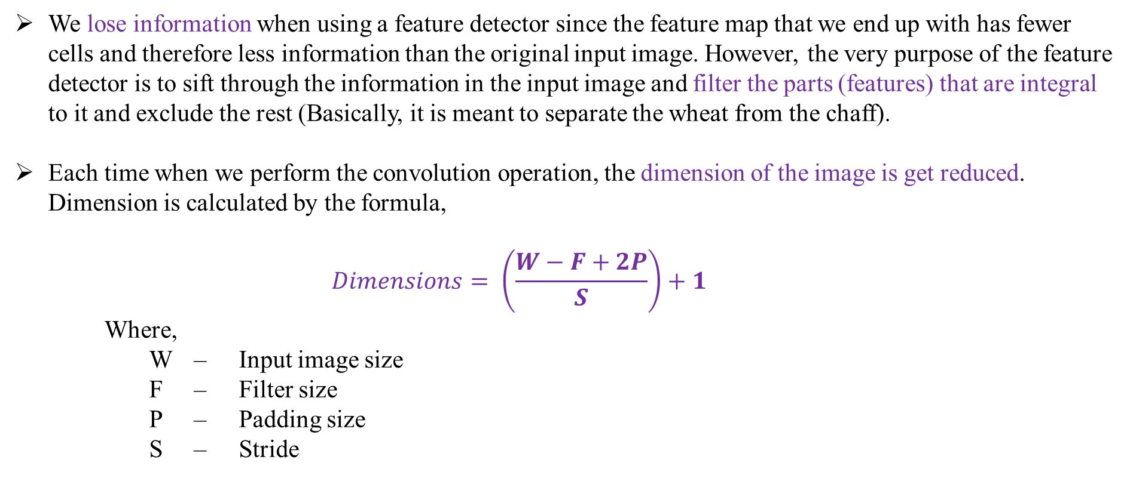
Convolution Operation
We lose information when using a feature detector since the feature map that we end up with has fewer cells and therefore less information than the original input image. However, the very purpose of the feature detector is to sift through the information in the input image and filter the parts (features) that are integral to it and exclude the rest (Basically, it is meant to separate the wheat from the chaff).
Each time when we perform the convolution operation, the dimension of the image is get reduced. Dimension is calculated by the formula,
$$Dimensions= \left(\frac{W−F+2P}{S}\right)+1$$
Where,
W – Input image size
F – Filter size
P – Padding size
S – Stride

Slide 35

Some Weight matrix

Slide 36
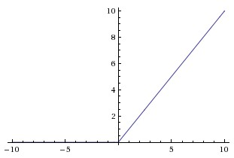
Activation Function : ReLU
Need For Relu: https://www.superdatascience.com/blogs/convolutional-neural-networks-cnn-step-1b-relu-layer
ReLU will give non-linearity to the neural network.
The function of ReLU is given by
f(x) = max(0,x)
Note: This layer does not affect the dimension of the image.
ReLU function

Slide 37
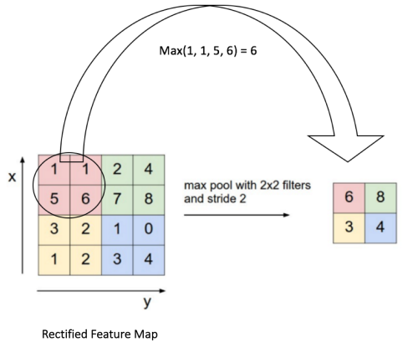
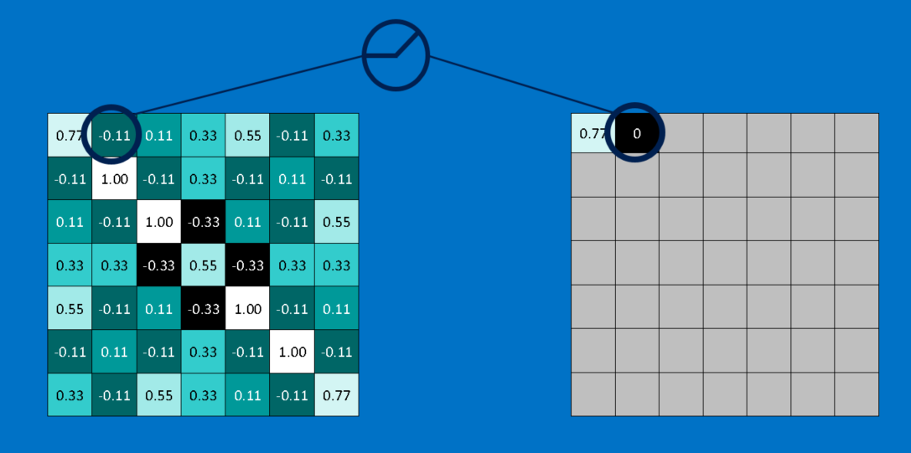
Pooling layer
Used for
makes the input representations (feature dimension) smaller and more manageable.
reduces the number of parameters and computations in the network, therefore, controlling overfitting.
helps us arrive at an almost scale invariant representation of our image.
After pooling, we apply Relu(Rectifier Linear Units) function.
Max Pooling

Slide 38
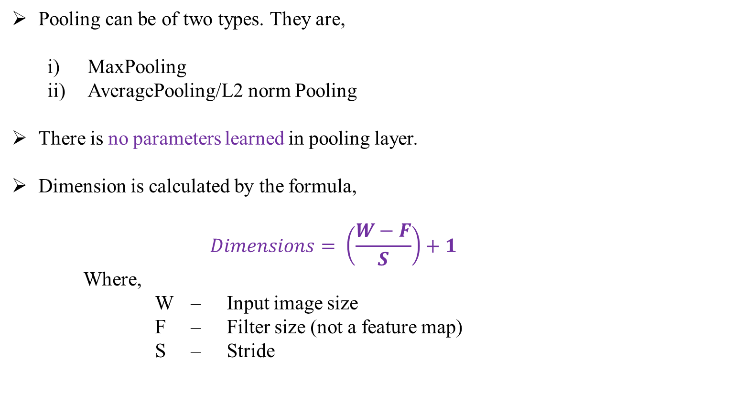
Pooling layer
Pooling can be of two types. They are,
MaxPooling
AveragePooling/L2 norm Pooling
There is no parameters learned in pooling layer.
Dimension is calculated by the formula,
$$Dimensions= \left(\frac{W−F}{S}\right)+1$$
Where,
W – Input image size
F – Filter size (not a feature map)
S – Stride

Slide 39
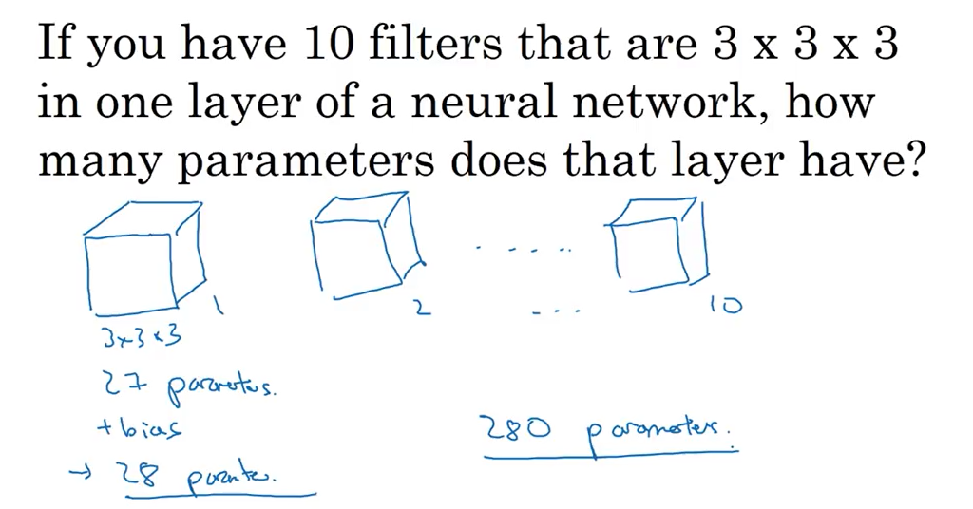
Number of Parameters ( θ or W_{ji} )
Parameters depends on the dimension of the filter and bias.
Parameter doesn’t depend on Dimension of input image, hence we can use any higher res images as well.
This will reduce the underfitting and overfitting problems.

Slide 40
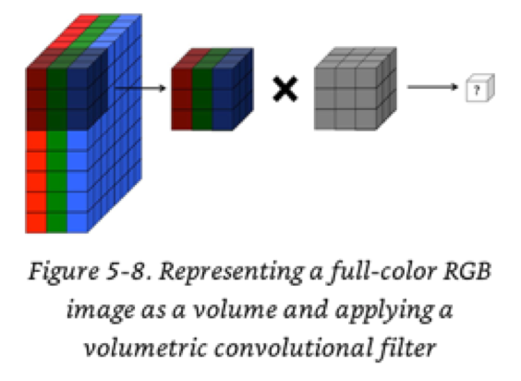
Convolution over RGB image
1x1 first entry
3x3x3 first entry
3x3x3 filter
8x8x3 input image

Slide 41
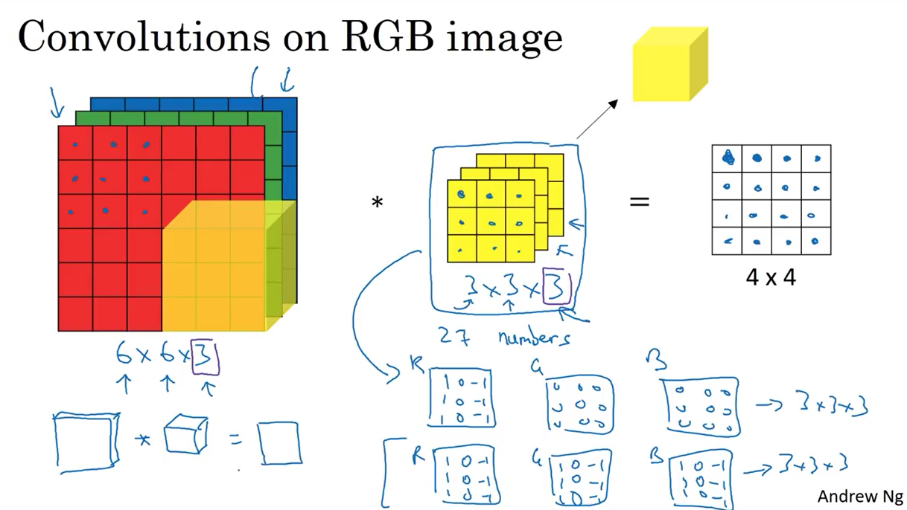

Slide 42
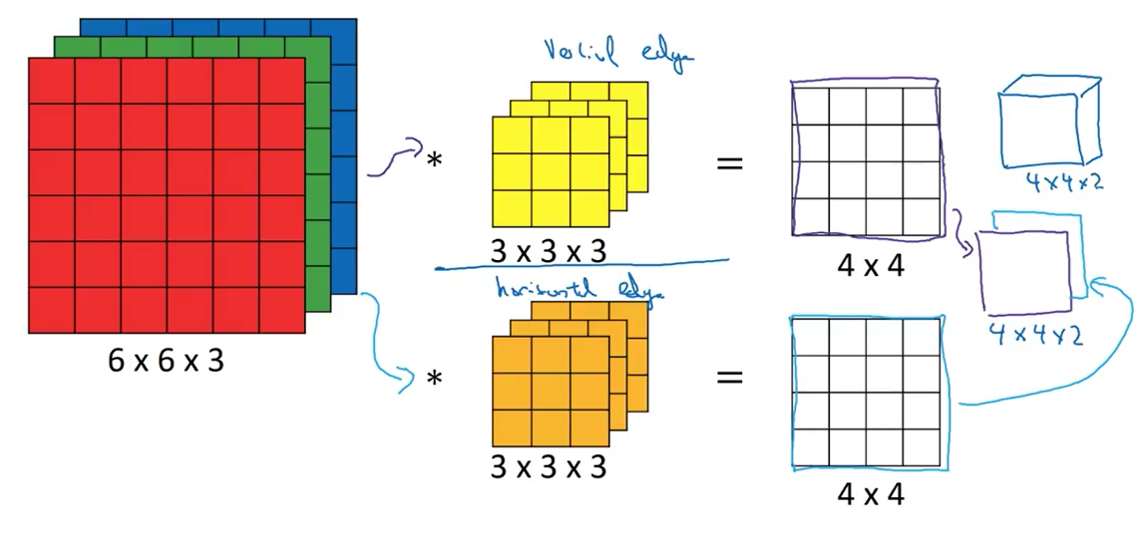
Multiple Filter

Slide 43
Flatten layer
This layer is used to convert the final feature map into a separate value (each element of the matrix is converted into separate value).
The each value is taken as input for the fully connected layer. (kind of input layer for the fully connected layer (classifier)).

Slide 44
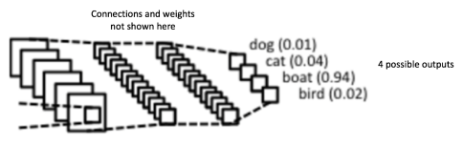
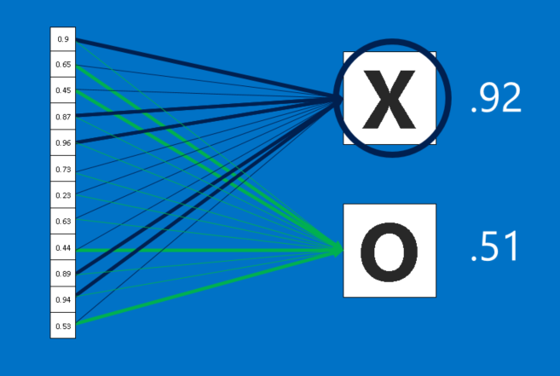

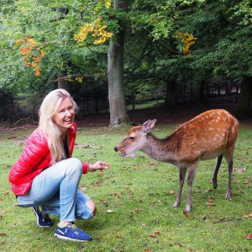
Fully Connected Layer
The output from the convolutional and pooling layers represent high-level features of the input image.
The purpose of the Fully Connected layer is to use these features for classifying the input image into various classes based on the training dataset.
Activation function : Softmax which gives probability values from 0 to 1.

Slide 45
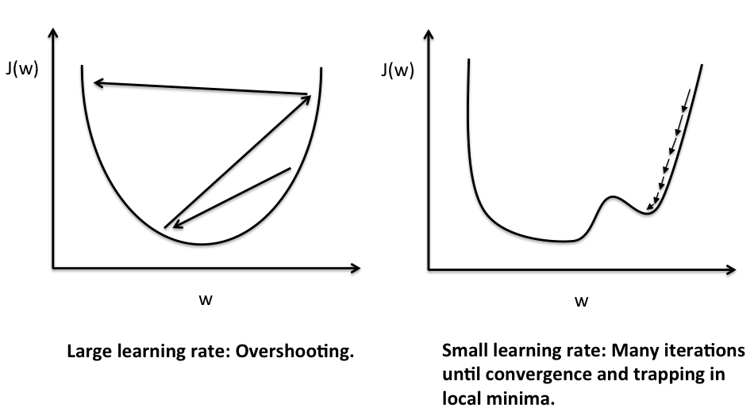
Improving the accuracy
Experimenting with the Hyper-Parameters
Learning Rate (α)
Iterations
Hidden layers
Optimizer
Loss function
Activation Functions and so on…

Slide 46
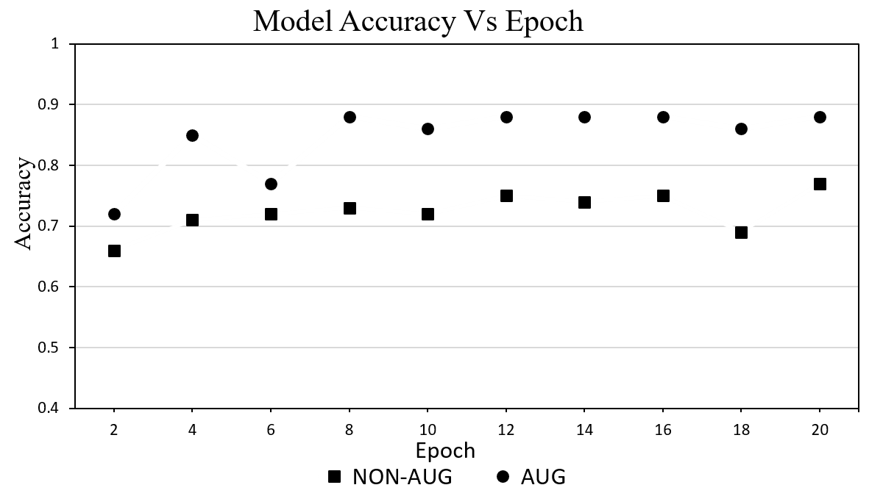
Improving the accu racy
Large Dataset results in increased accuracy.
Non- augumented Dataset contains 4810 images.
Augumented Dataset contains 10,650 images.

Slide 47
Difficulties while designing new architecture
Weight tuning
Random weight initialization.
Tuning the weights requires,
Large data needed to fine-tune the weights.
Large data means Larger training time and higher hardware resources needed to train the neural networks.
But larger the data, higher the accuracy.
Weight tuning will takes more time and more data.
Data size Accuracy Training Time hardware resources

Slide 48
Simple CNN model
150x150x3
Input layer
Conv2D_3x3 (256)
15x15x256
148x148x32
Conv2D_3x3 (32)
ReLU
15x15x256
148x148x32
ReLU
Maxpool_2x2
7x7x256
74x74x32
Maxpool_2x2
Flatten
7x7x256=12,544
72x72x64
Conv2D_3x3 (64)
72x72x64
ReLU
36x36x64
Maxpool_2x2
FC Layer (256)
34x34x128
Conv2D_3x3 (128)
34x34x128
ReLU
Output Layer
17x17x128
Maxpool_2x2

Slide 49
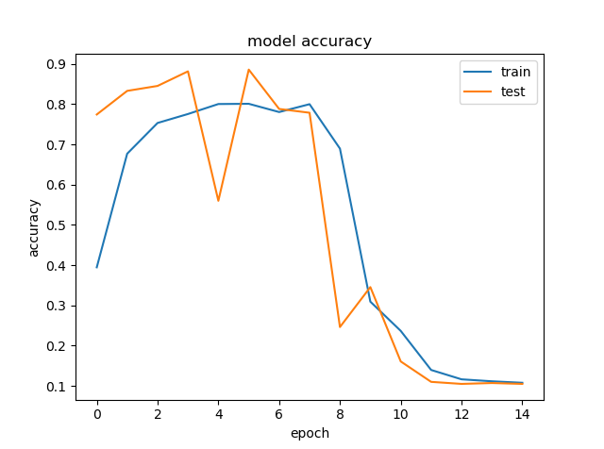
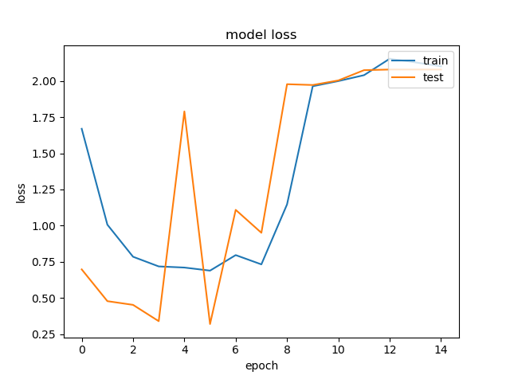
Model Performance
Model Accuracy
Model Loss

Slide 50
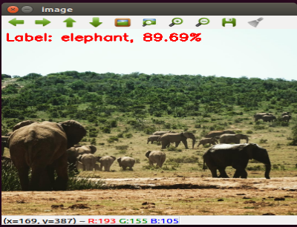
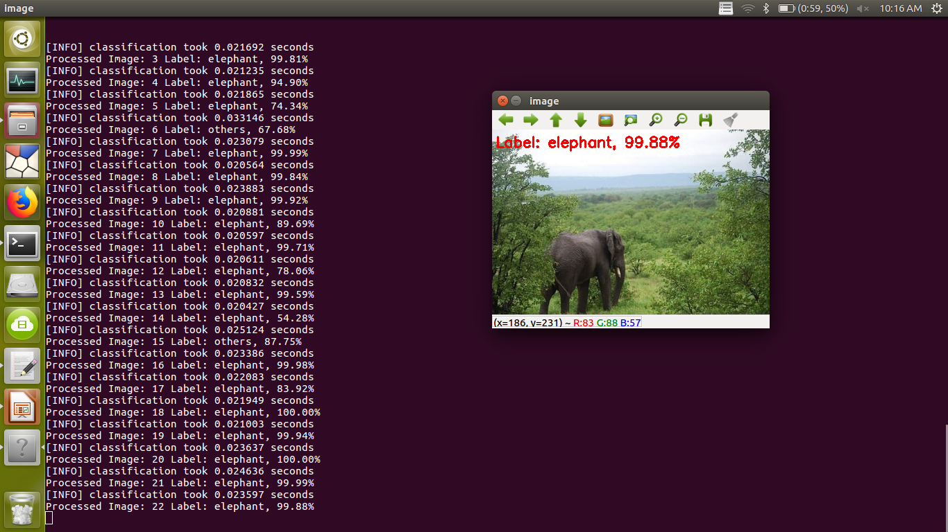
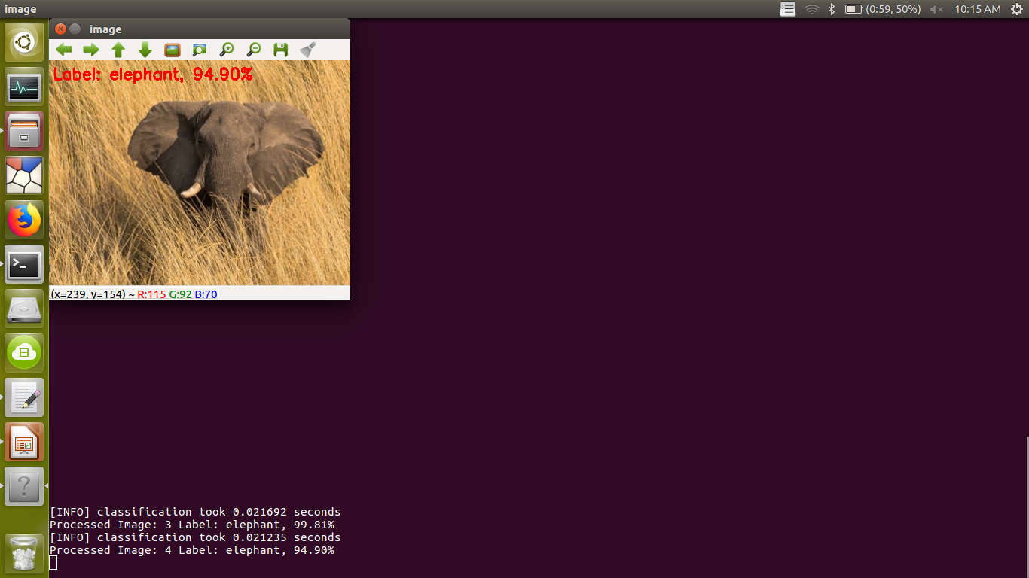
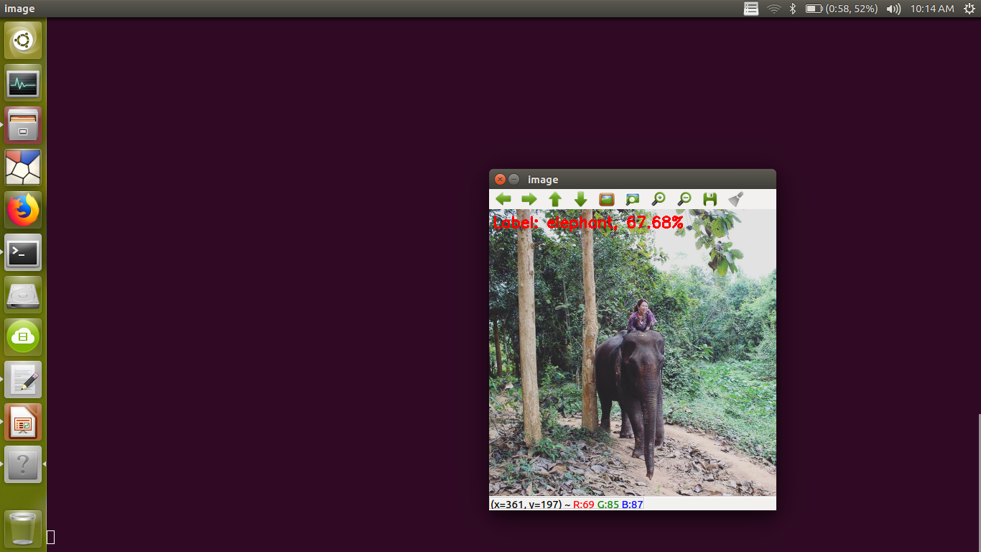
Image Classification
Elephant class

Slide 51
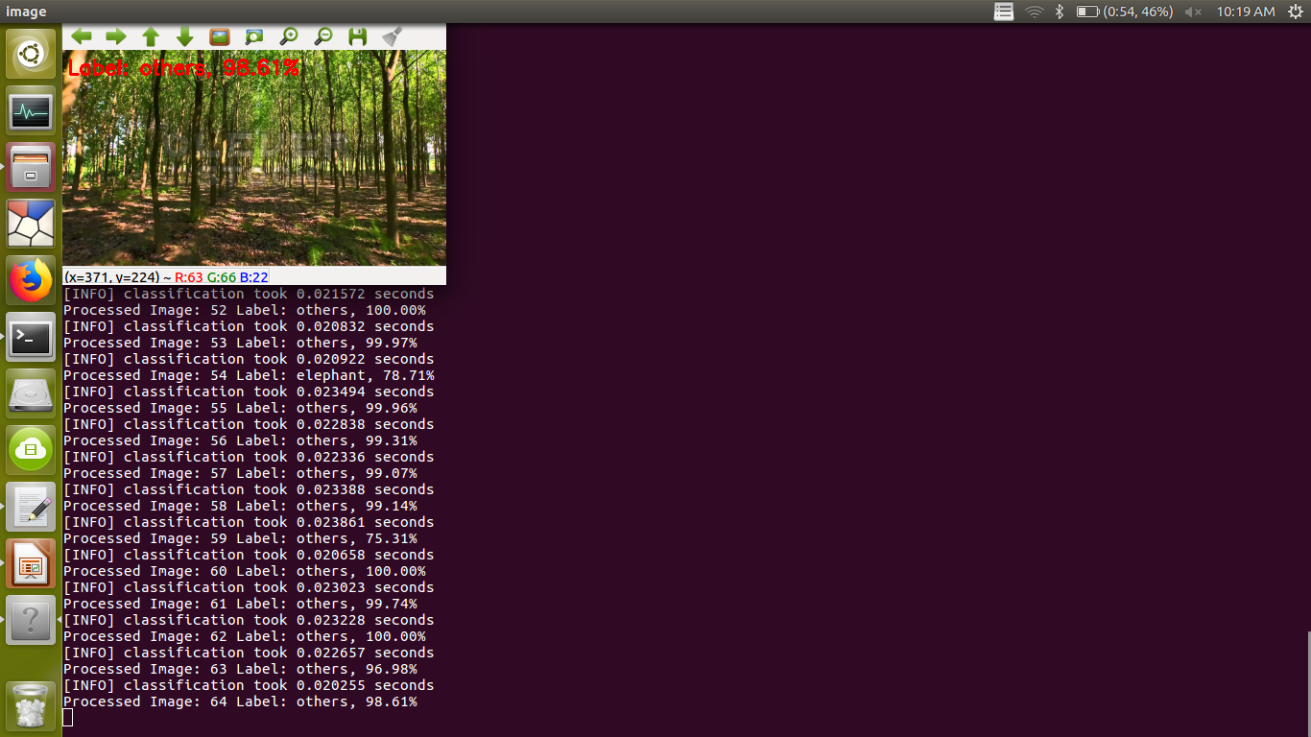
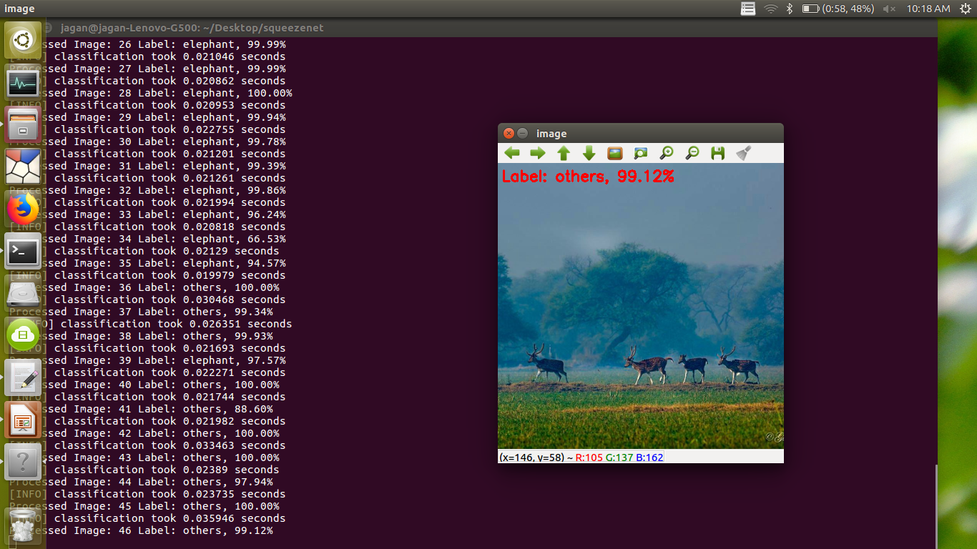


Image Classification
Others class

Slide 52
Thank You

